Slide 1
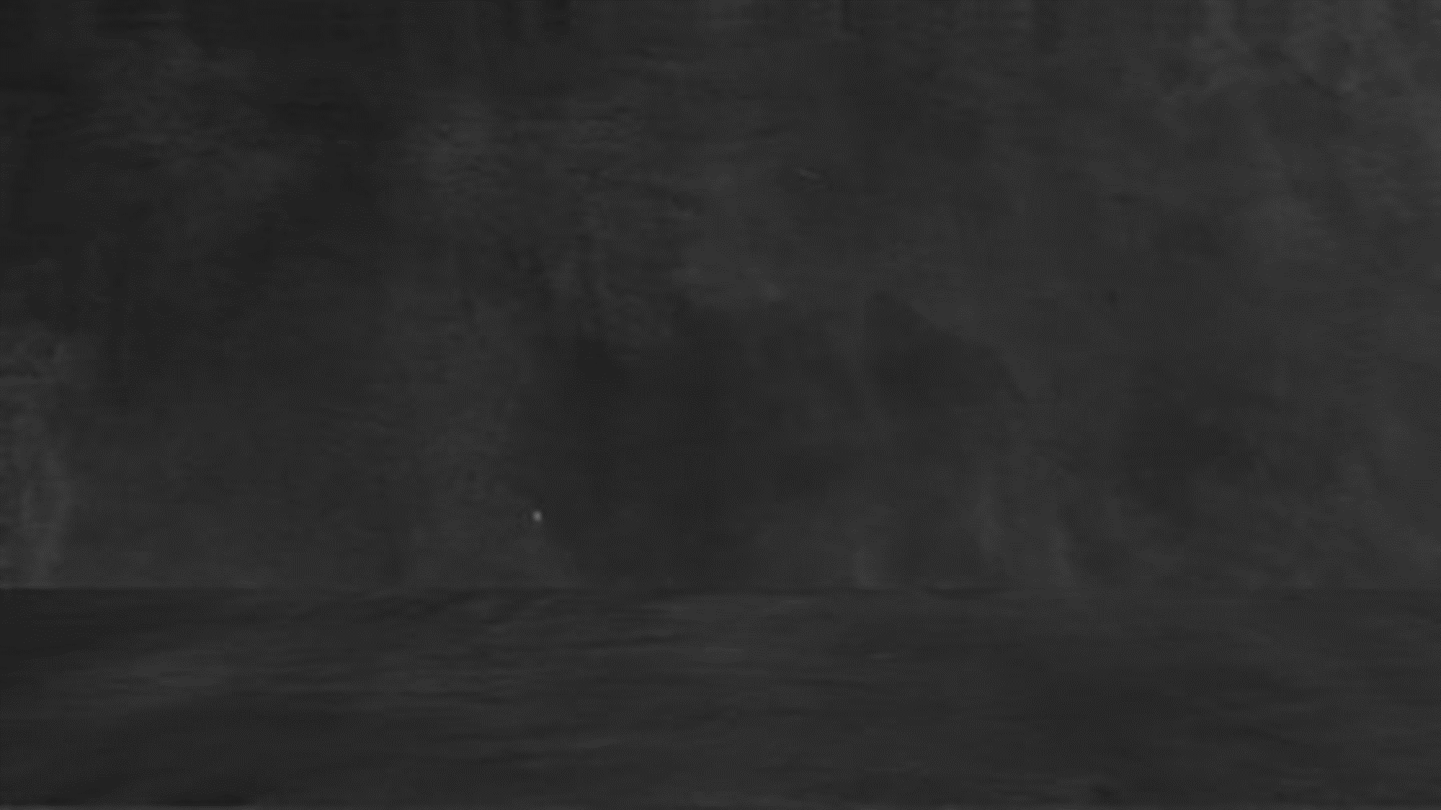
#BestEver
9th
Science-2
Second Unit Test
महाPractice
Maharashtra Board

Slide 2
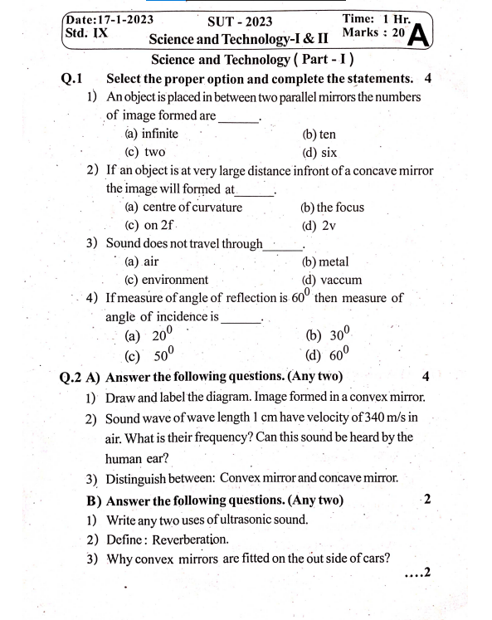
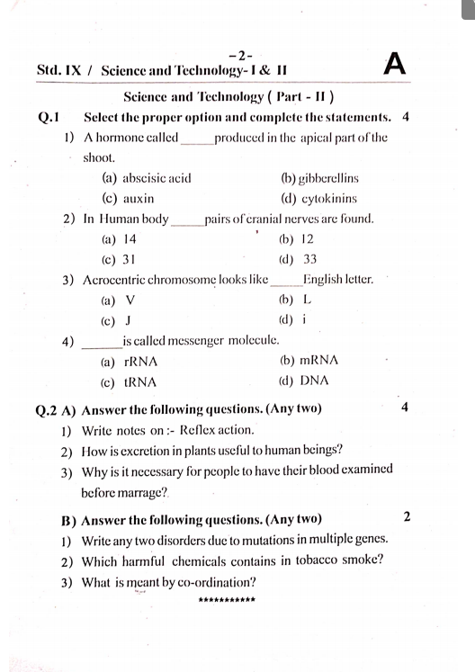

Let’s Solve with
Crystal concept
SUBSCRIBE

Slide 3
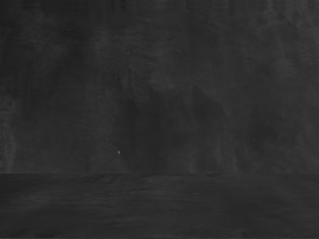
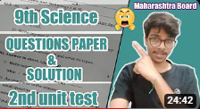
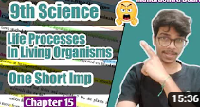
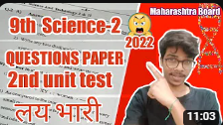
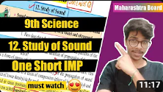
Crystal concept

Slide 4
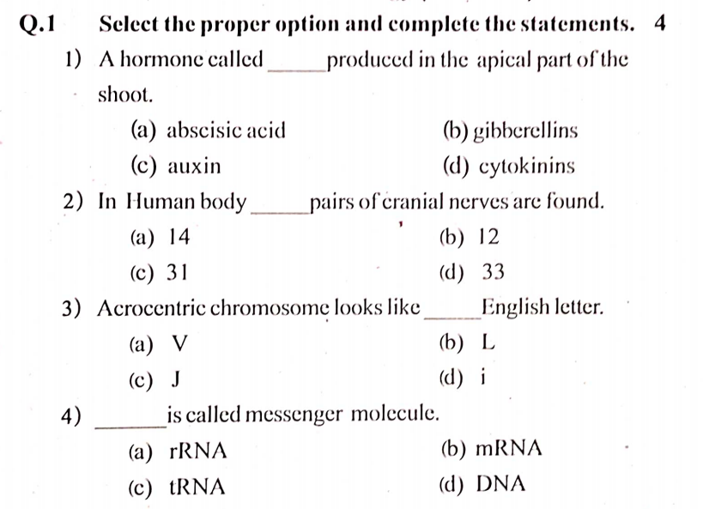

Crystal concept

Slide 5
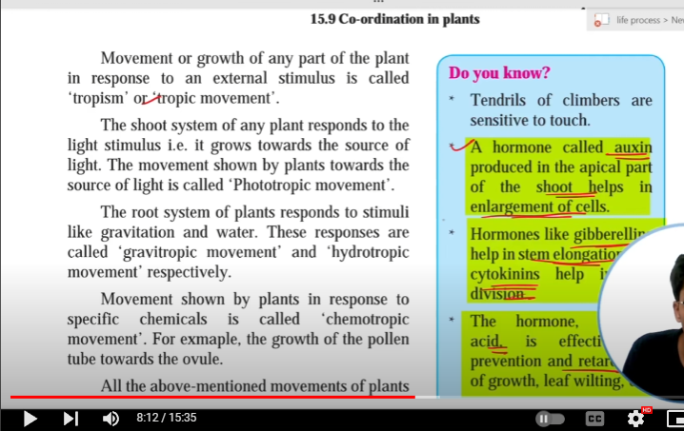
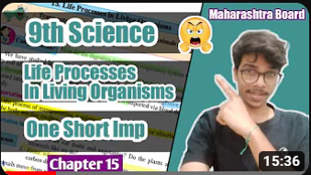

Crystal concept

Slide 6
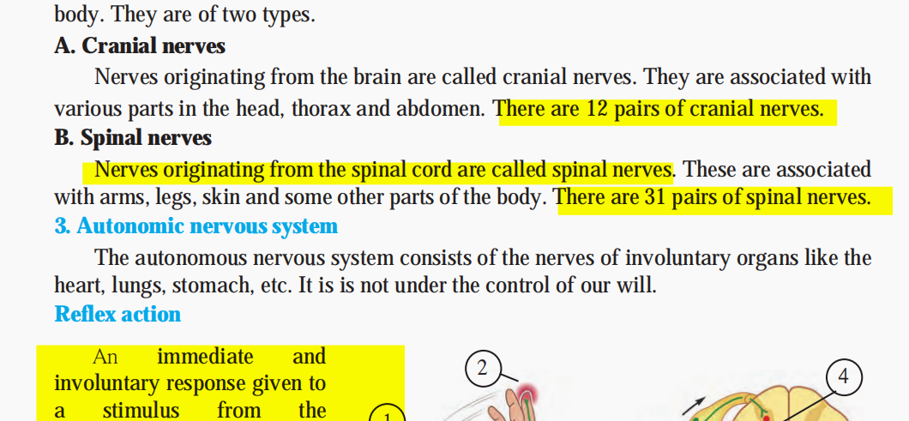

Crystal concept

Slide 7
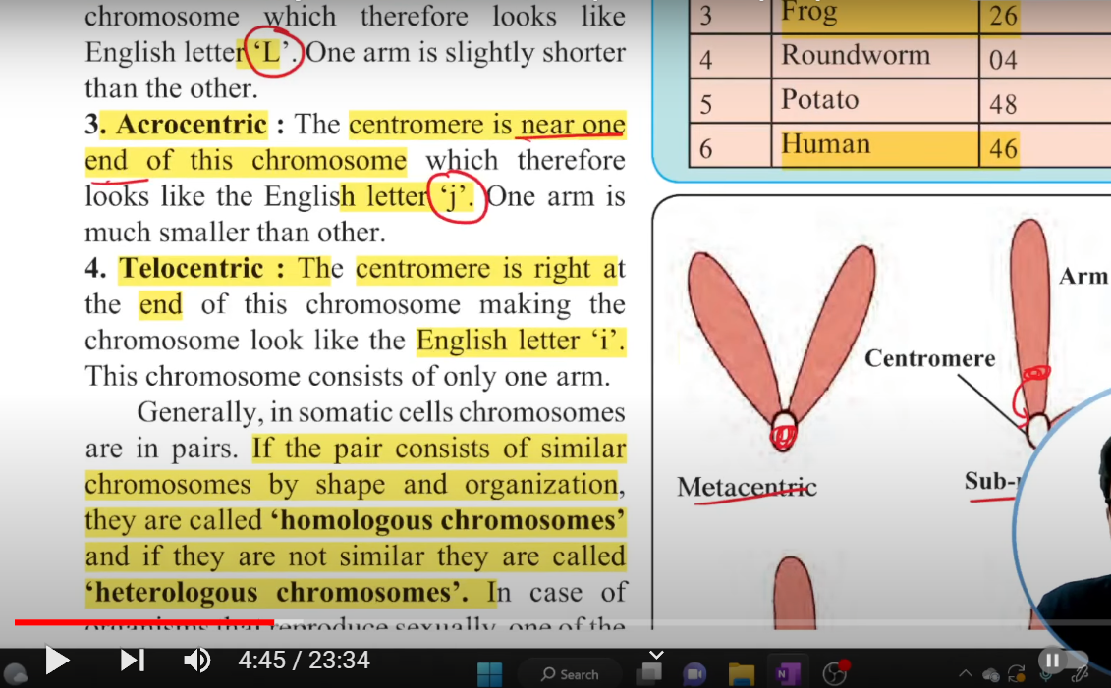
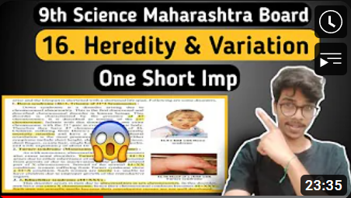

Crystal concept

Slide 8
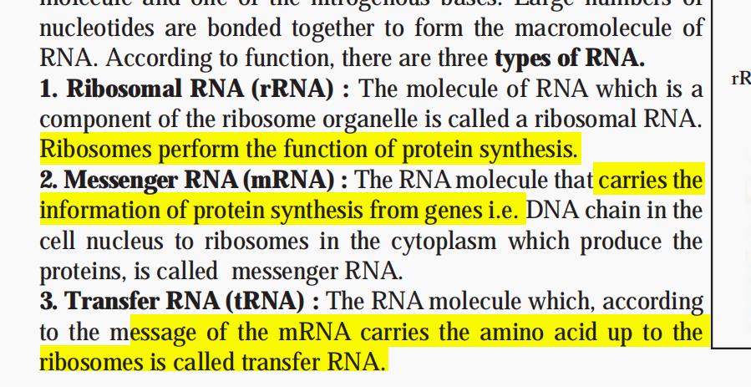
Crystal concept

Slide 9
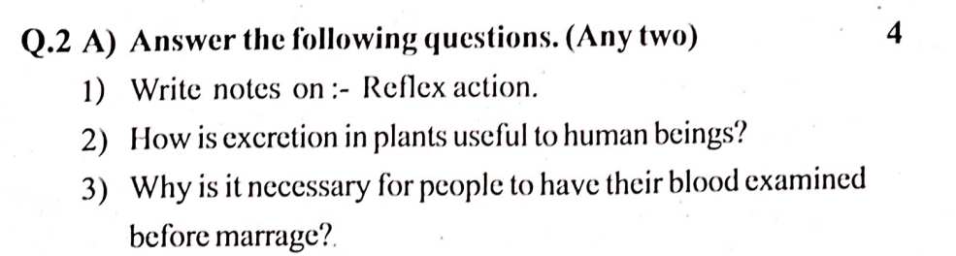
Crystal concept

Slide 10
Crystal concept
An Immediate and Involuntary response given by a stimulus from environment is called reflex action.
The sensory nerves that detect the stimulus are connected to nerves that move the muscles. Such a connection is called a reflex arc.

Slide 11
Crystal concept
The following examples are helpful in proving the above fact: 1. Oxygen which is an excretory product of photosynthesis is an absolute requirement for human beings to survive on earth.
2. Tannin is a waste plant product which is stored in leaves and bark. it is used in making tea all over the world.
3. Plants store waste products in their leaves and barks which are shed off regularly. These shed offs are used to make manure.
4. Essential oils are also waste products of plants which are stored in their leaves. These essential oils are used for various purposes by us.

Slide 12
Crystal concept
Sickle-cell anaemia is a hereditary disease. It occurs due to changes in genes during conception. If the father and mother are both affected by sickle-cell anaemia or if they are carriers of this disorder, their offspring are likely to suffer from this disease. Hence, marriages between the persons who are carriers of or suffering from sickle-cell anaemia should be avoided.
This disease is spread in only one way i.e. reproduction. Hence, husband and wife should get their blood exmined either before marriage or after it.

Slide 13
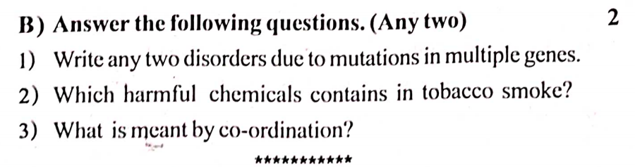
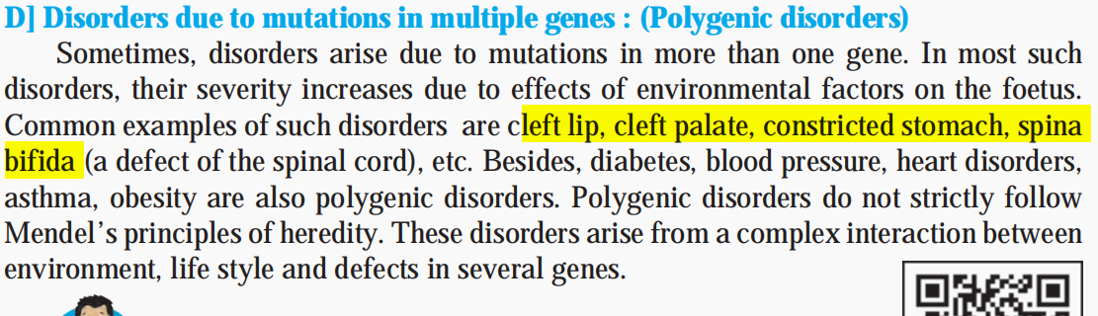
Crystal concept

Slide 14
Crystal concept

Slide 15
Crystal concept

Slide 16
Crystal concept
SUBSCRIBE

